Slide 1
WF6000 PHY Test Tool
User Manual

Slide 2
1. COM Port setting

Slide 3
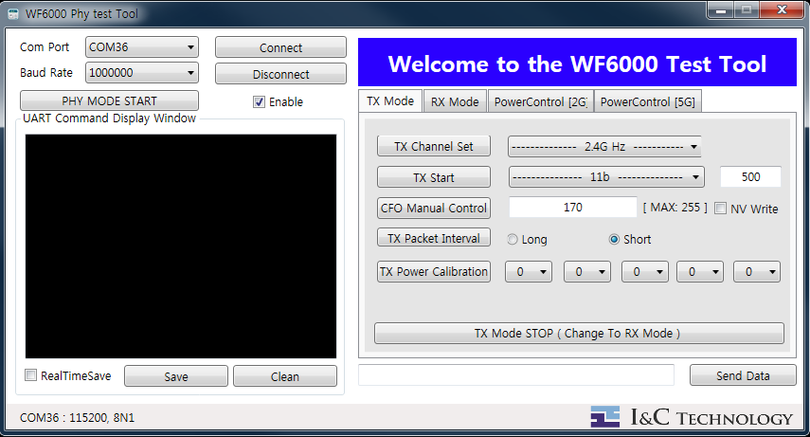
1.1 COM port Open
Click and Select COM port
1

Slide 4
1.1 COM port Open
Connect button click
1
2

Slide 5
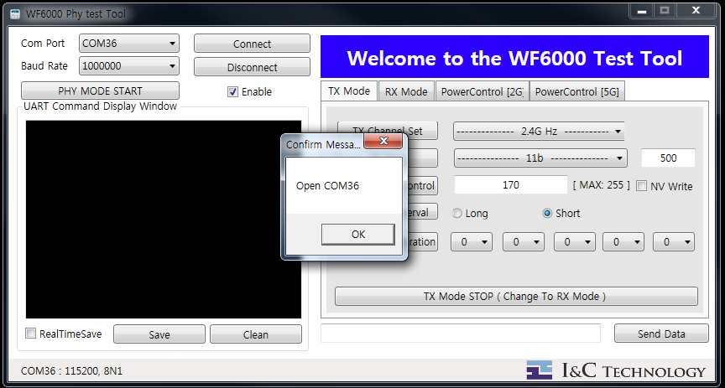
1.1 COM port Open
1
2
3
pop up message

Slide 6
1.1 COM port Open
1
2
OK Click,
Then Comport open.
4
3

Slide 7
2. Tx Phy test
TX Channel setting Command
Modulation , Coding , Number of PSDU Setting & TX Start Command
TX STOP Command
CFO Manual Control command
TX Packet Interval Control Command

Slide 8
2.1 TX Channel Setting Command
Select channel
1

Slide 9
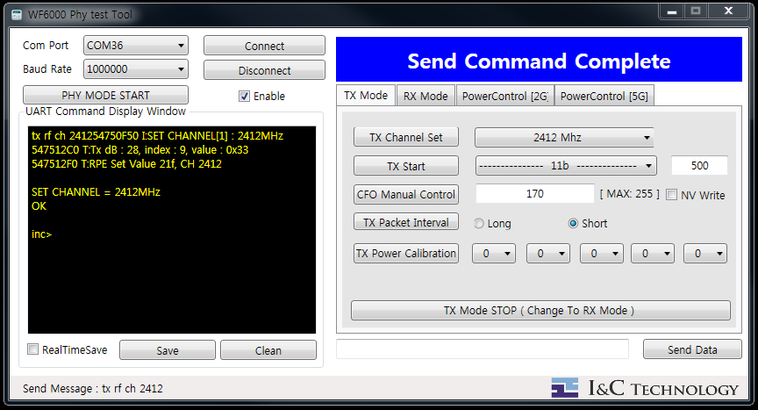
2.1 TX Channel Setting Command
1
2
Send TX Channel Set command.

Slide 10
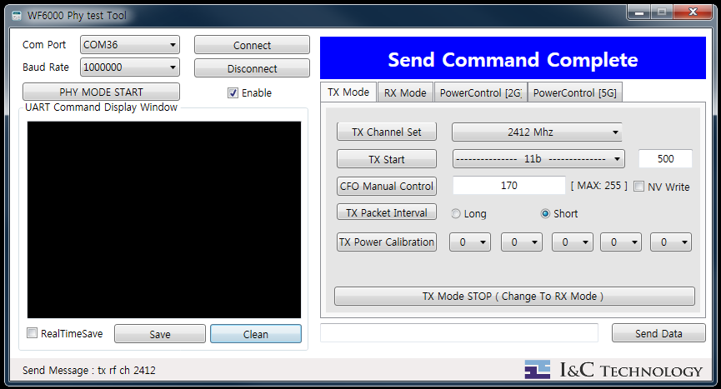
2.2 Modulation , Coding , Number of PSDU Setting & TX Start Command
1
Select Modulation and Coding

Slide 11
2.2 Modulation , Coding , Number of PSDU Setting & TX Start Command
Enter Number of PSDU [Byte] ( MAX :4096 / MIN : 100)
2
1

Slide 12

2.2 Modulation , Coding , Number of PSDU Setting & TX Start Command
Send TX start command in the set form (Modulation , Coding , PSDU number ) .
3
2
1

Slide 13
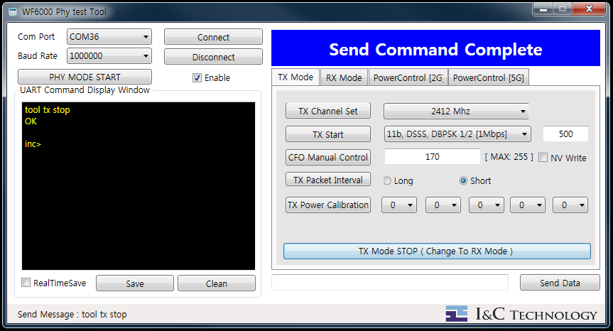
2.3 TX STOP Command
Send TX stop Command
1

Slide 14

2.4 CFO Manual Control command
1
Center Frequency Offset (CFO) Manual Setting ( MAX : 255 )

Slide 15
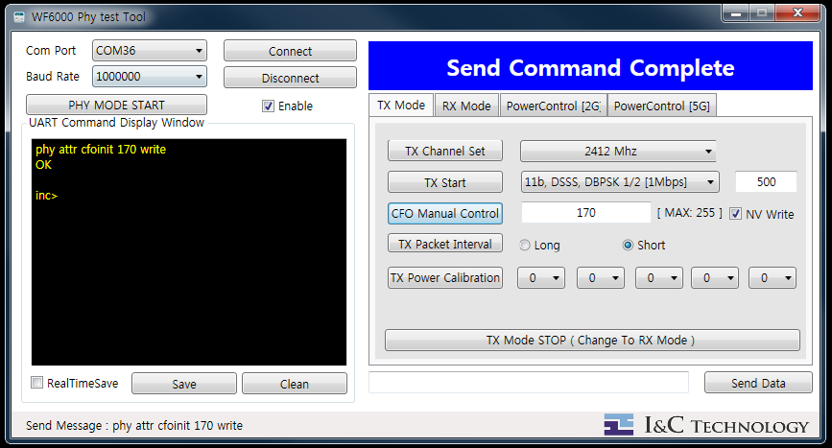
2.4 CFO Manual Control command
1
2
Send CFO value
Set 170 automatically when entering incorrect values
​​(Like a character).

Slide 16
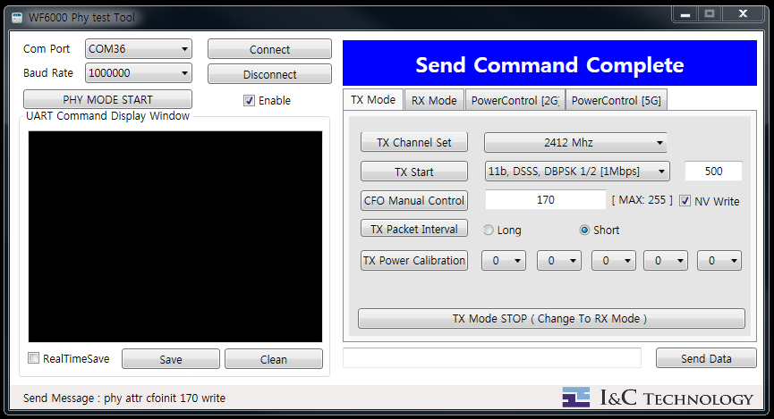
2.5 TX Packet Interval Length Control
1
Select TX Packet Interval
Short : 70 ms
Long : 200 ms

Slide 17
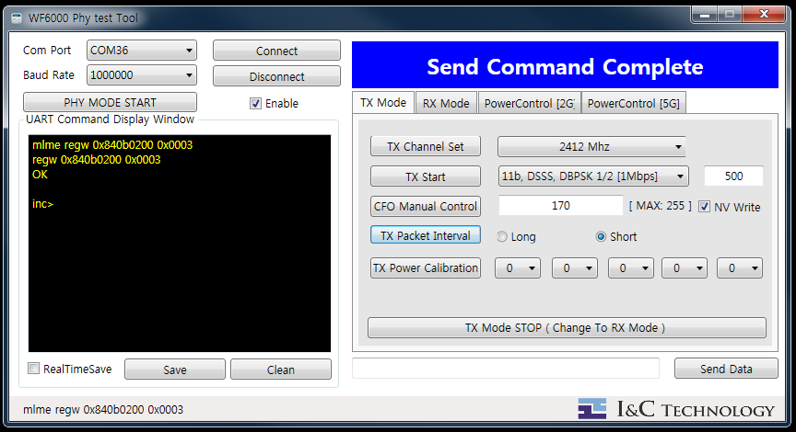
2.5 TX Packet Interval Length Control
Send Interval Value
2
1

Slide 18
3. Rx Phy test
RX Channel Command
Received packet confirmation command

Slide 19
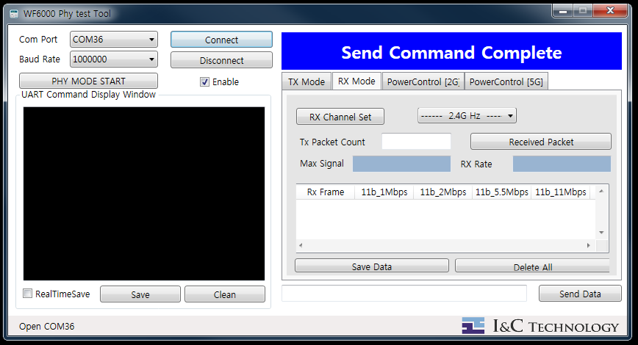
3.1 RX Channel setting Command
Select channel
1

Slide 20
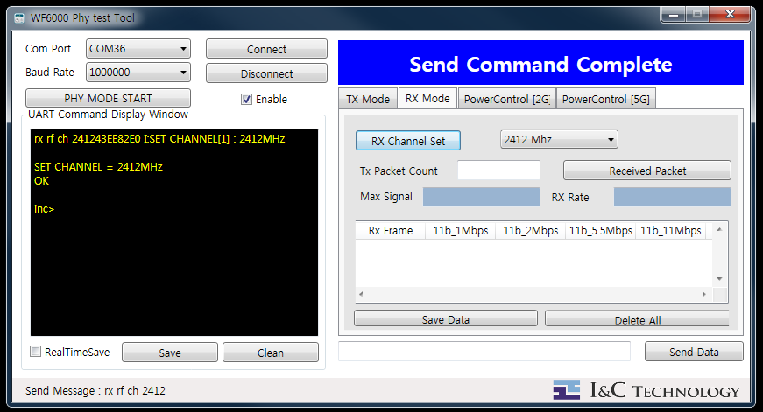
3.1 RX Channel setting Command
1
2
Send RX Channel Set command.

Slide 21
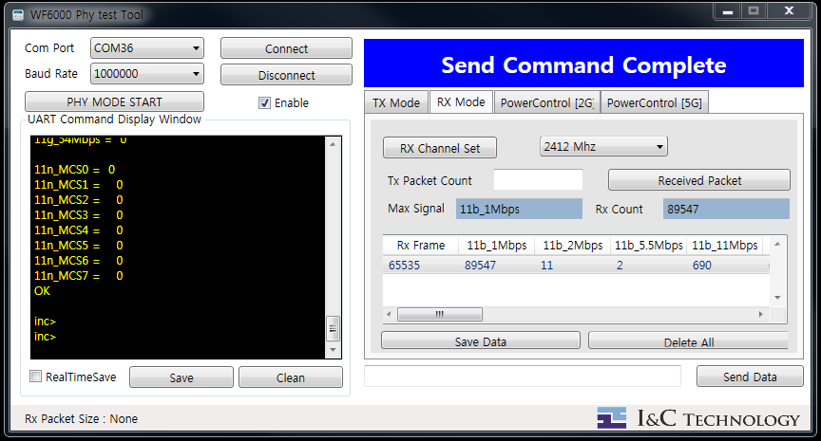
3.2 Received packet confirmation command
Received Packet confirmation command
If Tx Packet Count is empty
1
It shows the name of the most received packet among the received packet . (Read Only)
If the Tx packet Count is empty, It shows the number of the most received packet among received packets . (Read only)

Slide 22
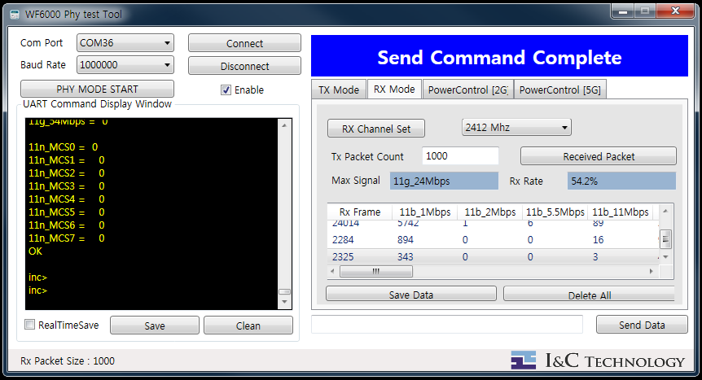
3.2 Received packet confirmation command
Received Packet confirmation command
If the Tx Packet Count has a specific value
1
It shows the name of the most received packet among the received packet . (Read Only)
If the Tx packet Count has a specific value, It shows the reception ratio of the most received packet among received packets . (Read only)
Example
( Real received packet / Tx packet Count )
( 542 / 1000 * 100 = 54.2% )

Slide 23
3.2 Received packet confirmation command
1
Specific values ​​are displayed in List.

Slide 24
3.2.1 List delete
List data delete
1

Slide 25
4. Data Save
Display Window Save
List Data Save

Slide 26
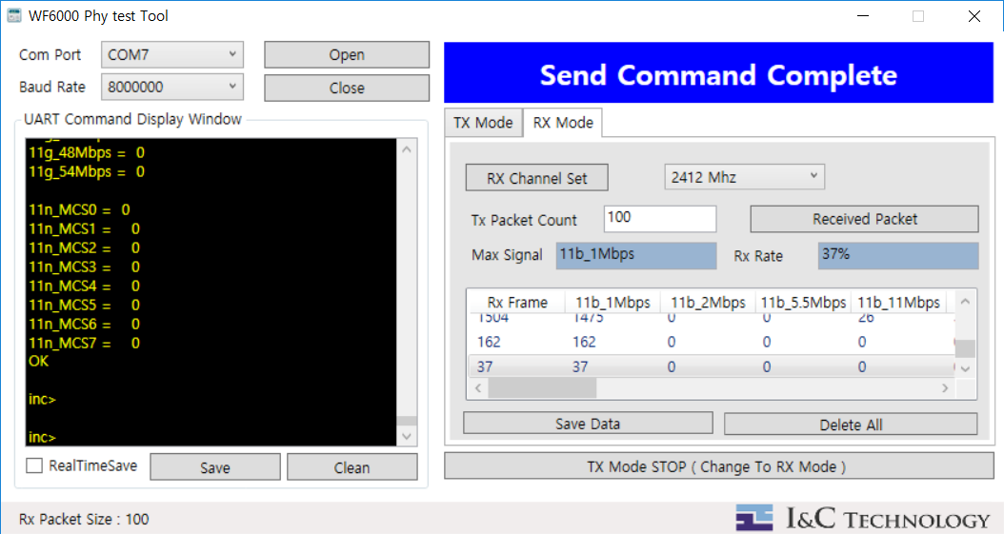
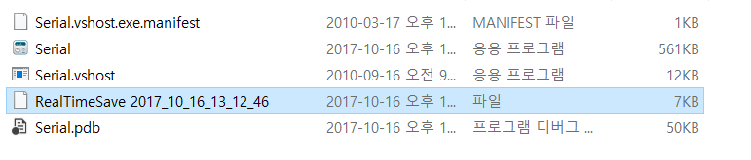
4.1 Display Window Save
Command Display Window real time save
1
RealTimeSave ( save start time )

Slide 27
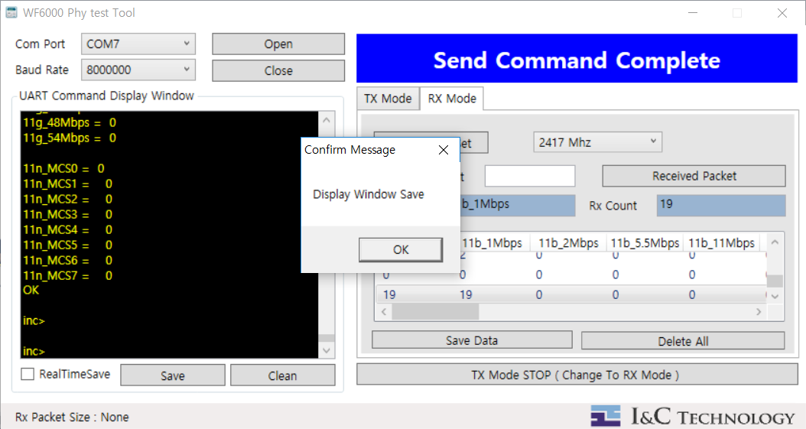
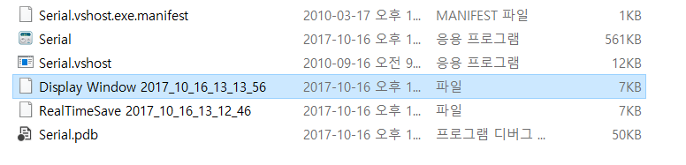
4.1 Display Window Save
Command Display Window Save current screen
1
DisPlay Window( Save Time )

Slide 28
4.2 Display Window Clear
Command Display Window Clear current screen
1

Slide 29
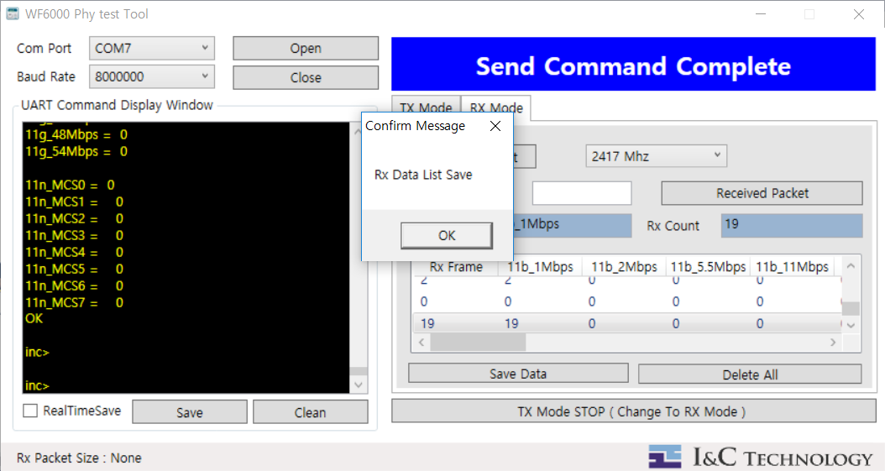
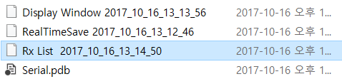
4.3 Rx data List Save
1
Rx data list save
Rx List ( Save Time )

